Slide 1
Film Analysis Descriptive Analysis
by: Josh Grimes

Slide 2
Table of contents
01
02
03
04
05
06
Overview
Business Problem
Data Understanding
Data Analysis
Recommendations
Next Steps

Slide 3
01
Overview

Slide 4



Overview
Buena Vista
Action
100 - 119 minutes

Slide 5
02
Business Problem

Slide 6
Business Problem
Don’t know anything about producing movies
What type of films are doing best at the box office

Slide 7
03
Data Understanding

Slide 8
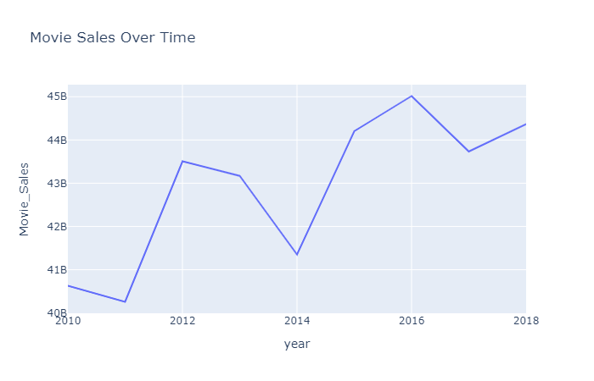
Data Understanding
Box Office Mojo (text)
3,356 entries from 2010 - 2018
Title, studio, sales, year
IMDB (database)
73,00 entries
Title, runtime, genres, rating

Slide 9
04
Data Analysis

Slide 10
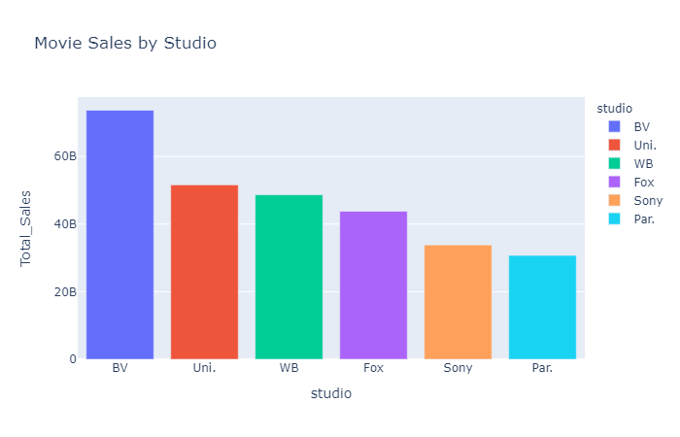
Data Analysis
Buena Vista studio has the most domestic income of any studio from 2010 - 2018

Slide 11
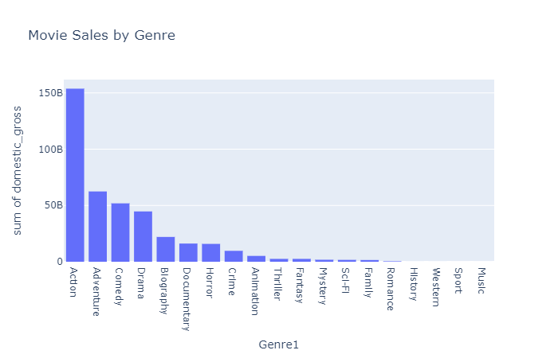
Data Analysis
Action films have the most domestic income of any genre from 2010 - 2018

Slide 12
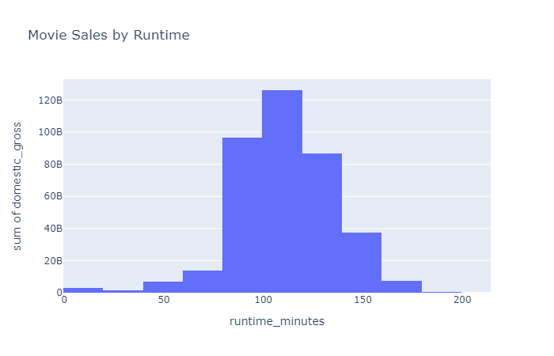
Data Analysis
100 - 119 minute films have the most domestic income from 2010 - 2018

Slide 13
05
Recommendations

Slide 14



Recommendations
Buena Vista
Action
100-119 minutes

Slide 15
06
Next Steps

Slide 16
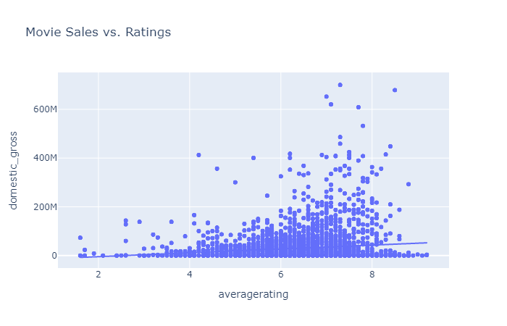
Next Steps
Cast and Crew
Production Budget
Advertising

Slide 17


Thank You

